Slide 1

Managing Your Budget

Slide 2
Overview
Managing your own budget as a self-directed Participant or Designated Representative can be overwhelming at first. This resource guide will help you become familiar with the tools and processes involved with effectively managing your budget.

Slide 3
What is Self-Direction?
Self-direction, also called consumer-direction, is a way for people who need long-term care to receive support and stay in their homes and communities.
Self-direction is about personal choice, control, and flexibility.

Slide 4
What are the Participants and Designated Representatives Responsibilities under the Self-Directed Model?
How Does Self-Direction Work?
In self-direction, you (or someone you trust to make choices for you) pick and train the people who care for you, plan when they’ll help, and choose how they’ll assist you.
With self-directed services:
You stay in your home and community.
You pick your caregivers, possibly even friends or family.
You manage your care. You are in charge.
You are also in charge of managing your budget.

Slide 5
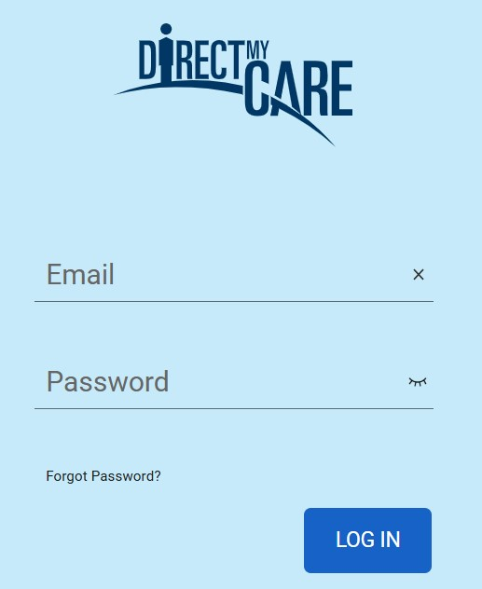
Finding Your Budget Reports and Documents
Participants and Designated Representatives can get budget summary reports and documents on the DirectMyCare Web Portal.
  First, sign into DirectMyCare.com (fig. 01).
  Participants and Designated Representatives will access reports differently.
  Participants can click here to learn more about accessing Summary Reports and how to read them.
  Designated Representatives can click here to learn more about accessing Summary Reports and how to read them.
Fig. 01

Slide 6


Accessing Reports and Documents as a Participant
Once signed in to DirectMyCare.com, find and click your name in the upper right corner of the screen (fig. 02).
Once redirected, click "Summary Reports" to view a breakdown of your budget (fig. 03).
Your Name
Fig. 02
Fig. 03

Slide 7
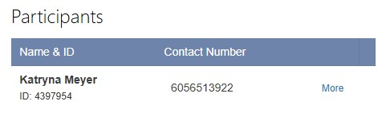
Accessing Reports and Documents as a Designated Representative
Once signed into DirectMyCare.com, find the "Participants" section on the right side of your screen (fig. 04).
Then, click "more" next to a Participant (fig. 04).
Once redirected, click the "Summary Reports" button to view your budget breakdown (fig. 05).
Fig. 05
Fig. 04

Slide 8


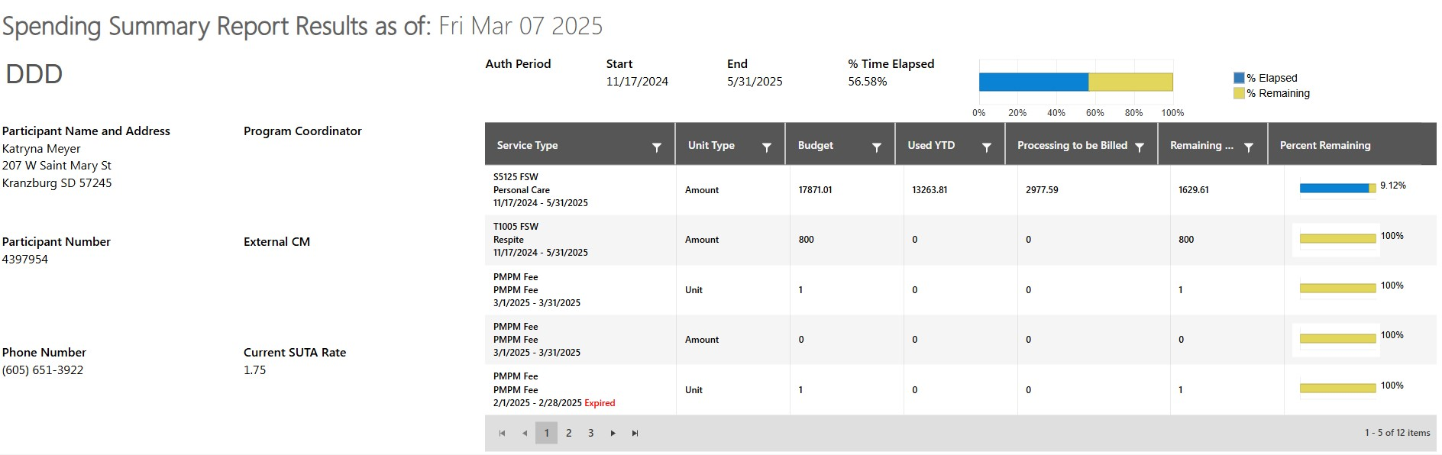

Spending Summary Report
Auth Period: start and end dates for your annual budget to be used.
Percent Time Elapsed: this is a breakdown of time elapsed and time remaining within your annual auth period.
Percent Remaining: this is the number of dollars for that service type for the current time frame.

Slide 9


Spending Summary Report
Service Type: You may have multiple service types. Each service type will have its own budget amount.
Budget: this is the number of dollars for the service type during the current time frame.
Used YTD: this is amount of dollars in your budget that you have used this plan year.
Processing to be Billed: this is the amount of dollars in your budget that has been used but is still being processed.
Remaining: this is the amount of dollars in your budget that you have remaining for that service type.

Slide 10
Monthly Authorization Limits per Service Type
Companion Care (T1020 FSW; T1020 GRP) - $3,500/month
Respite (T1005 FSW; T1005 GRP) - $2,500/month
Personal Care (S5125 FSW) - $3,500/month

Slide 11
Example 1: How to use the Summary Report
Trina is a developmentally disabled adult who lives at home with her family. She has budgets for Personal Care, Respite, and Companion Care services.
Trina's parent is her Designated Rep (DR) and her family members take turns as caregivers providing services for Trina. They are each paid $15/hour no matter the service they are provided. Trina needs to use the dollars for these services between 8/25/24 and 5/31/25.
NOTE: The amount caregivers are paid will directly affect how quickly the budget is used up.

Slide 12
Example 1: How to use the Summary Report
It is the DR's responsibility to be aware of Trina's budget and schedule and pay caregivers within that budget. So, it's important to plan ahead, track time, and use the summary report to maintain awareness.
Trina's schedule stays pretty consistent every week. She will need a caregiver between the hours of 10:00am to 3:00pm Monday – Friday. That comes out to 25 hours a week.
25 hours a week X $15/hour = $375 a week.
  Don't forget that CDSD adds 12.88% fee, so $375 X 12.88% = $423.30 a week
$423.30 X 40 weeks = $16,932
  Trina's DR needs to schedule according to the available budget for each service within the time frame.
  It’s important to regularly monitor to make sure you don’t exceed the budget for each service.

Slide 13
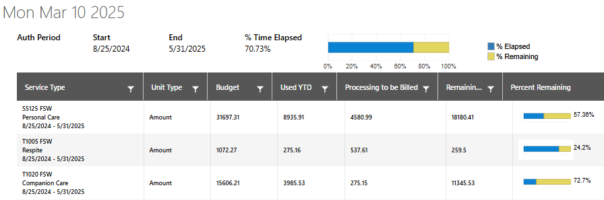
Example 1: How to use the Summary Report
When Trina's DR looks at her summary report, there are some key things to pay attention to.
The Time Elapsed graph should roughly match the Percent Remaining graphs for all three services.

Slide 14
Example 1: How to use the Summary Report
When Trina's DR looks at her summary report, there are some key things to pay attention to.
Trina's DR needs to keep an eye on the remaining amounts to determine if she has enough left to claim Medicaid dollars to meet Trina’s needs through the end of the planned budget.

Slide 15
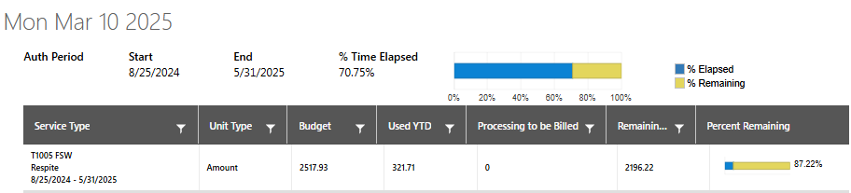
Example 2: How to use the Summary Report
Adam is a 9-year-old with multiple disabilities. His only budgeted service is respite, which is typically provided when he is on breaks from school, instead of consistently throughout the year.
Adam’s parents must look at his total budget for respite, determine how many hours they will need during the plan year (8/25 – 5/31), and decide how much they will be able to pay a caregiver without exceeding their budget.

Slide 16
Adam’s parents need to know the total amount in Adam’s budget to plan ahead.
Adam’s total budget is $2517.93 and he anticipates needing respite services:
Aug. 26-30 – 30 hours
Sept. 3 – 6 hours
Dec. 23, 26, 27, 30, Jan. 2, 3 – 36 hours
Mar. 17 – 21 – 30 hours
$2517.93 / 102 hours = $24.68
  Don't forget that CDSD adds 12.88% fee
102 hours X $20 an hour = $2040
  $2040 X 12.88% = $2,302.75 (this will give Adam’s family a little extra in case they need additional hours)
  Or Adam’s family can pay their caregiver $21/hour, which will use $2417.89
102 hours of Respite

Slide 17
Example 3: How to use the Summary Report
Katherine lives in her home and receives companion care. Katherine has a friend come over once in a while to help out. She doesn’t have a consistent schedule for her companion care and uses it irregularly. Katherine has agreed to pay her caregiver $30/hour to provide companion care.
Katherine’s sister, who is the DR, must make sure that Katherine is not going over her budgeted amount by keeping good records and frequently checking the Summary Report. Her January records may look like this:
1/17 - 3 hours = $101.59 (3 X $30 = $90. $90 X 12.88% = $101.59)
1/27 - 1.5 hours = $50.80 (1.5 X $30 = $45. $45 X 12.88% = $50.80)
Jan Total $152.39

Slide 18
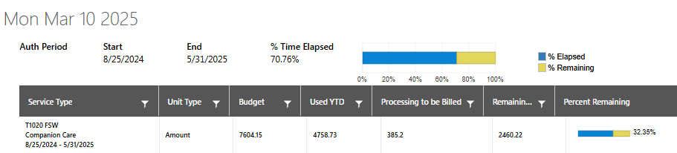
Example 3: How to use the Summary Report
Katherine’s sister also needs to keep good records of how much time Katherine anticipates using the caregiver in the future. She needs to check the Summary Report regularly to look at the remaining balance. Her records anticipating Feb may look like:
2/3 – 3 hours = $101.59 (3 X $30 = $90. $90 X 12.88% = $101.59)
Anticipated 2/12 – 5 hours = $169.32 (5 X $30 = $150. $150 X 12.88% = $169.32)
Anticipated 2/25 – 1.5 hours = $50.80 (1.5 X $30 = $45. $45 X 12.88% = $50.80)
Anticipated Feb total = $321.71

Slide 19
Questions?
If you need additional support with understanding your budget, reach out to your CDSD Program Coordinator. They will be able to work with you so you can gain a better understanding of how to efficiently manage your budget.

